Slide 1

Sprocket Central Pty Ltd
Piyush Singh

Slide 2
Agenda
Introduction
Data Exploration
Model Development
Interpretation

Slide 3


Introduction
Problem Statement:
Sprocket Central Pty Ltd , a medium size bikes & cycling accessories organization, has given us a new list of 1000 potential customers with their demographics and attributes. (However, these customers do not have prior transaction history with the organization.)
Our goal:
The marketing team at Sprocket Central Pty Ltd want to know about useful customer insights which could help optimize resource allocation for targeted marketing. Hence, improve performance by focusing on high value customers.

Slide 4



Introduction
Dataset Overview:
Sprocket Central Pty Ltd has provided three datasets.
They include Customer Demographics, Customer Addresses, and Transactions.
We also have a New Customer List (the target data).
Data Preparation Steps:
We cleaned and improved data quality.(with the help of Excel & Power BI)
Merged the datasets to create a comprehensive view.
Data Exploration
Explored the data to uncover insights.
This sets the stage for data-driven decisions.

Slide 5
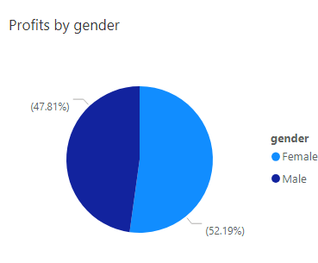
Data Exploration
Total Sum of Profits by Genders
Insights:
Females generated higher total profits: Female ($56,95,691.08) vs. Male ($52,18,066.32).
Females accounted for 52.19% of the total profit.

Slide 6
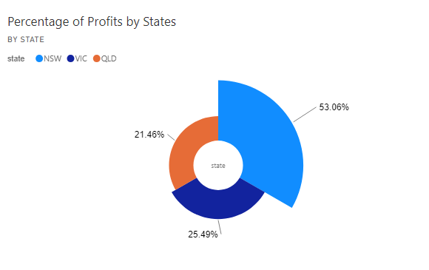
Data Exploration
Percentage of profit by States
State Insights:
NSW contributed 53.06% to the total profit pool, with VIC and QLD generating $27,81,600.10 and $23,41,816.45 in profits, respectively.

Slide 7
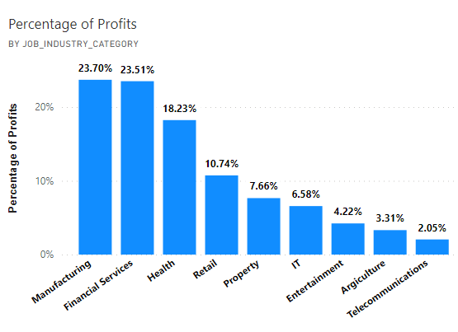
Data Exploration
Percentage of profit by Job industries category
Insights:
"Manufacturing" had the highest profit percentage at 21.70%, while "Telecommunications" had the lowest at 1.87%.
The top three industries for profit percentage were "Manufacturing" (23.70%), "Financial Services" (23.51%), and "Health" (18.23%).

Slide 8
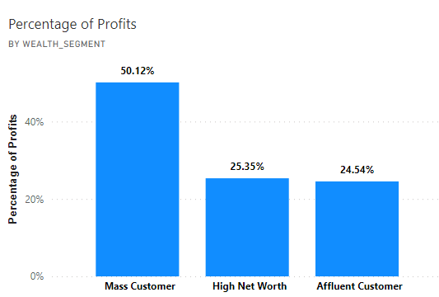
Data Exploration
Percentage of profit by Customer Wealth Segment
Insights:
"Mass Customer" led with a profit percentage of 50.12%.
Top three segments: "Mass Customer" (50.12%), "High Net Worth" (25.35%), "Affluent Customer" (25.54%).

Slide 9
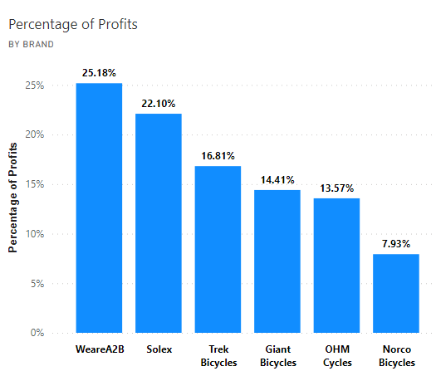
Data Exploration
Percentage of profit by Brand
Insights:
The distribution of profit contributions across brands was as follows: "WeareA2B" accounted for 25.18%, "Solex" contributed 22.10%, and "Track Bicycle" contributed 16.81% of the total profits

Slide 10
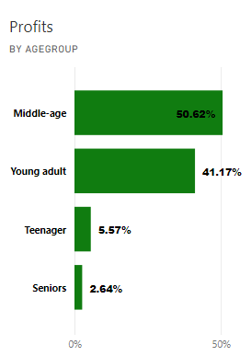
Data Exploration
Profit by Age Groups
Insights:
Middle- age group had the highest profits at 50.62% higher than Senior’s age group at 2.64%.
Middle-age accounted for 50.62 % of total profits.

Slide 11
Model Development
Model Development and Implementation: Targeting Customer Preferences
Customer between age Middle & Young age.
Customers in the Mass Consumer Segment.
Customers related to Financial Services and Manufacturing Industries.
Customers living in New South Wales.

Slide 12
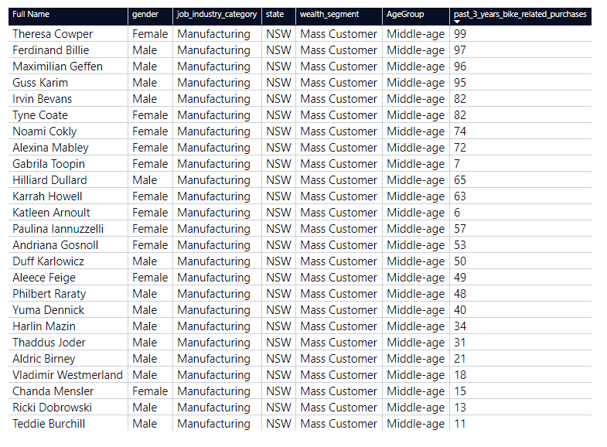
Interpretation
Filtering by most profitable State, age group, wealth segment, job category to find a New list of targeted customers

Slide 13
Appendix
Clean Data: https://1drv.ms/x/s!Avt95xtN2eTJqC2rDNAP3oD-weKR?e=n4cZ4e

Slide 14
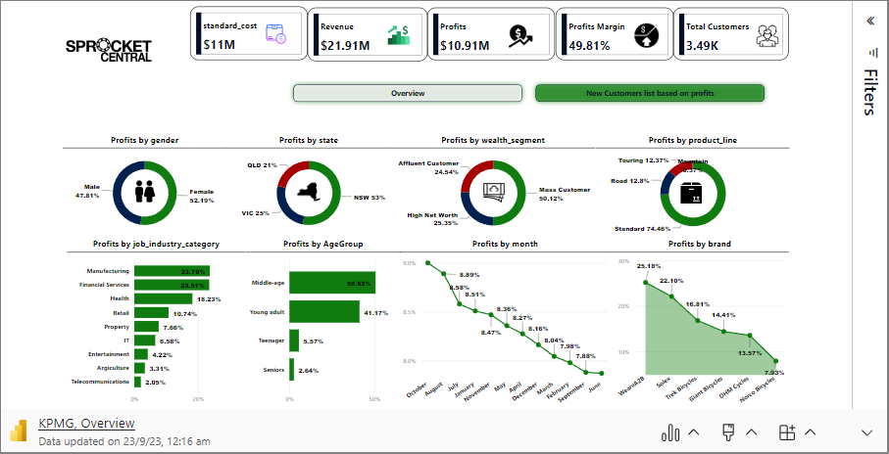
Dashboard

Slide 15
Thank you

